Slide 1
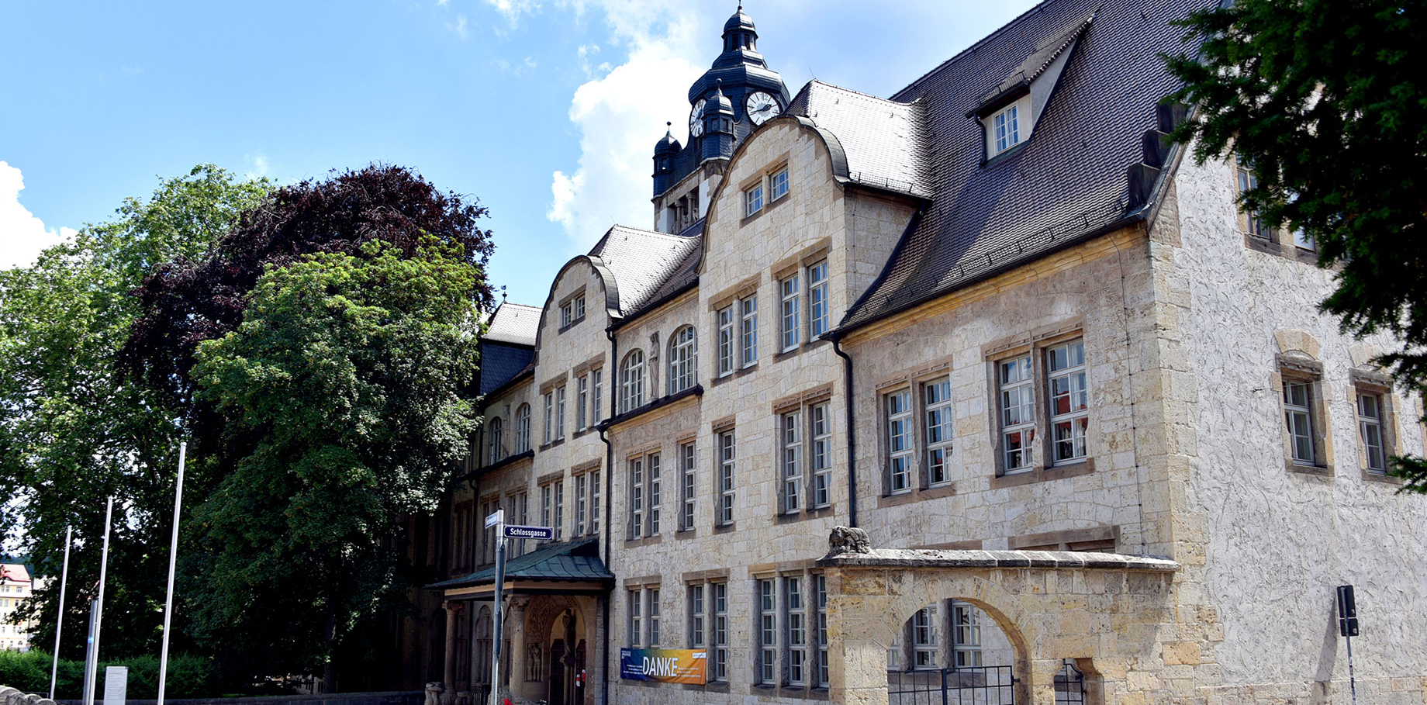
Camera-Enabled
Linear Encoder
Felix Fleisch, Bruno Reinhold AWP 3D Project
Foto: Anne Günther

Slide 2

Agenda
Motivation
Project Overview
Theoretical Concepts
Project Evaluation
Project Demonstration

Slide 3
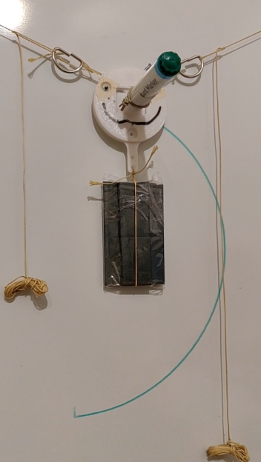
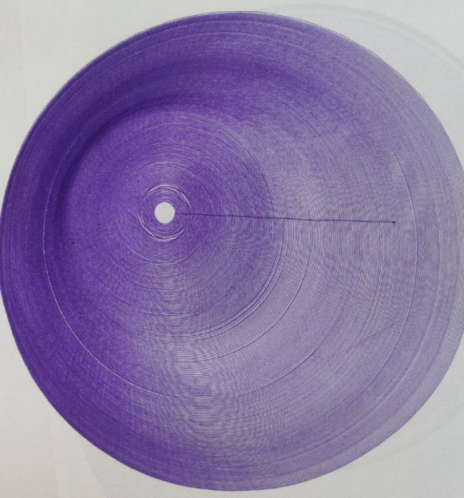
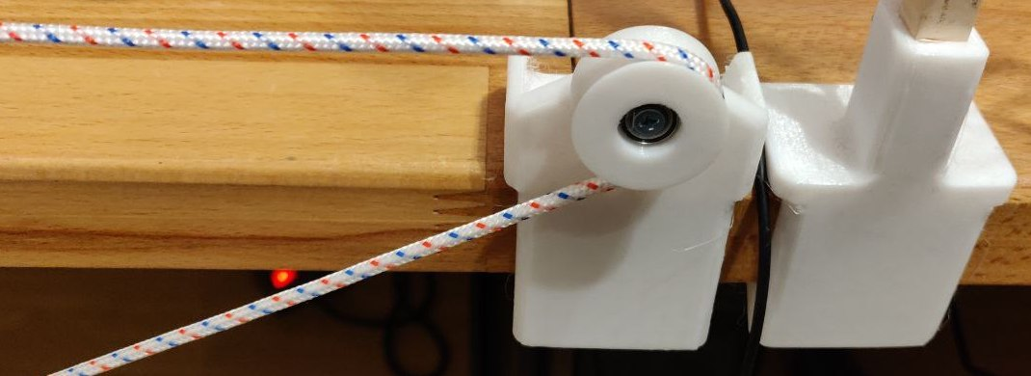
Motivation
idea:
-> develop linear encoder for 2D-V-Plotter
problem:
-> ropes of the linear encoder “slip” over the pulley
-> small error builds up
-> the bigger the 2D-plotter gets the larger the error
solution:
-> decode the movement of the rope from its pattern
to track the exact position
-> align assumed and actual position of the plotter head
Foto: Jan-Peter Kasper
Foto: Jan-Peter Kasper
Figure1: 2D-plotter head (top-left), erroneous plot (top-right), slipping pulley (bottom)

Slide 4
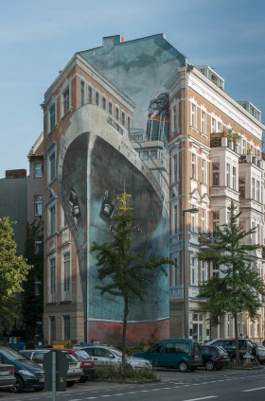
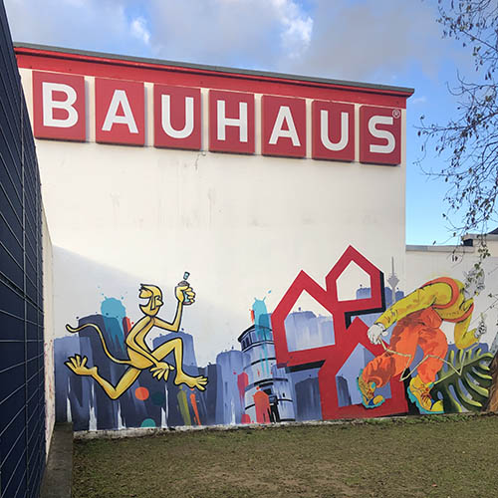
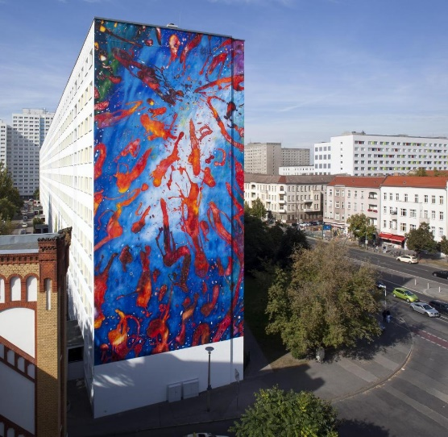
Motivation
Vision:
-> linear encoder scalable to
large plotter systems
-> painting on residential and
commercial buildings
-> advertisement
-> CNC – machines utilizing
ropes
Foto: Jan-Peter Kasper
https://www.sueddeutsche.de/geld/wandbilder-alles-fassade-1.3613836#
https://www.orig-ami.de/wp-content/uploads/2021/01/Graffitiauftrag_Bauhaus_2020_thumbnail.jpg
https://img.welt.de/img/finanzen/immobilien/mobile128119005/1852505567-ci102l-w1024/WS-Finanzen-Fassadenkunst.jpg
Figure 2: Examples of painted houses

Slide 5
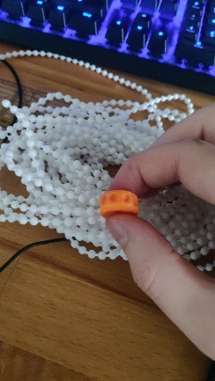
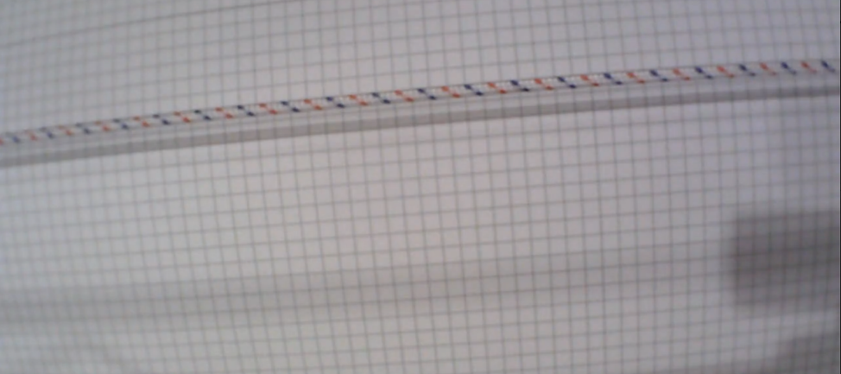
Project Overview
Goal of the project:
-> build a camera-enabled linear encoder
python software library
-> applicable to ropes and chains
Foto: Jan-Peter Kasper
Figure 3: non-slipping chain (left), rope (right)

Slide 6
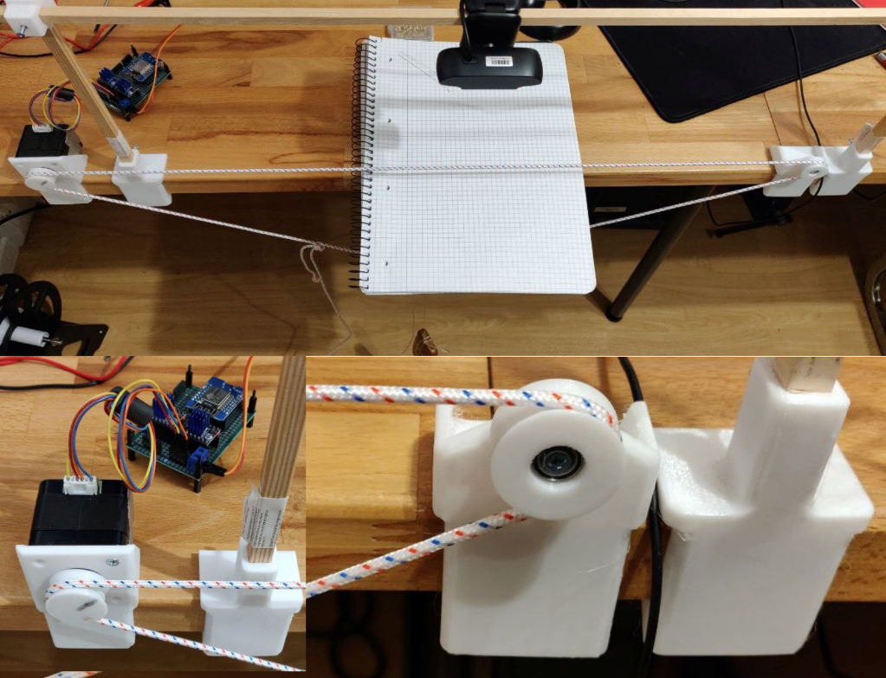
Project Overview
Roadmap:
1) Build Testbed for recording test footage
2) Developing the linear encoder prototype
2.1) Identify region of interest
2.2) detect shift of rope or chain
3) Refactor the prototype into a software library
Figure 4: testbed overview (top), left motor detail view (bottom left), pulley detail view (bottom right)

Slide 7
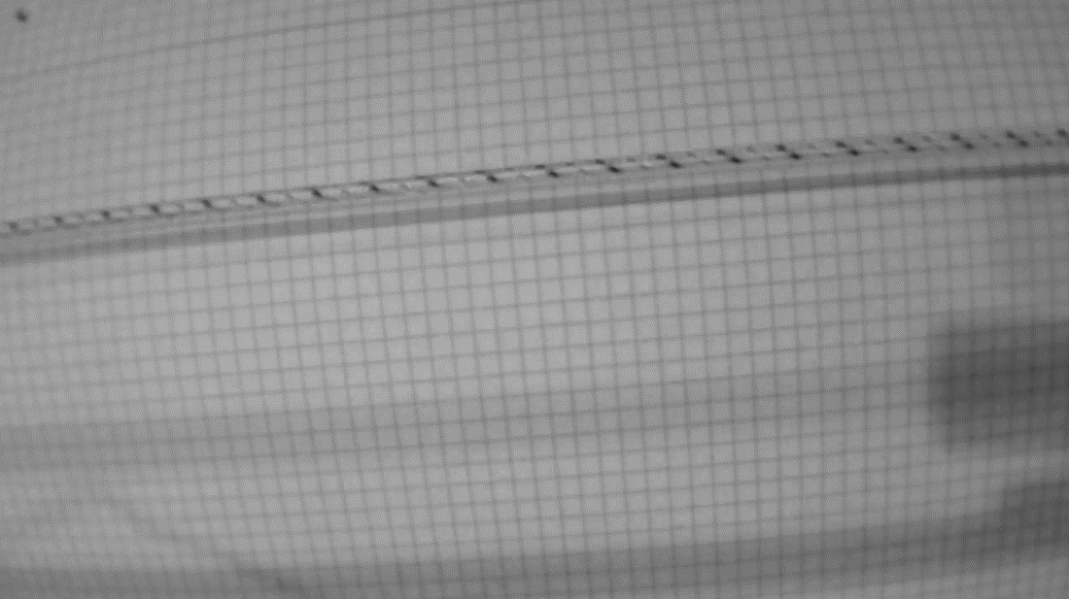
Theoretical Concepts
Limits of the Method
-> Nyquist-Shannon-Sampling Theorem
-> Encoding of rope possible up to certain speed
-> limited by framerate of camera
-> pattern on rope must be periodical
Figure 5: periodical pattern (red color channel)

Slide 8
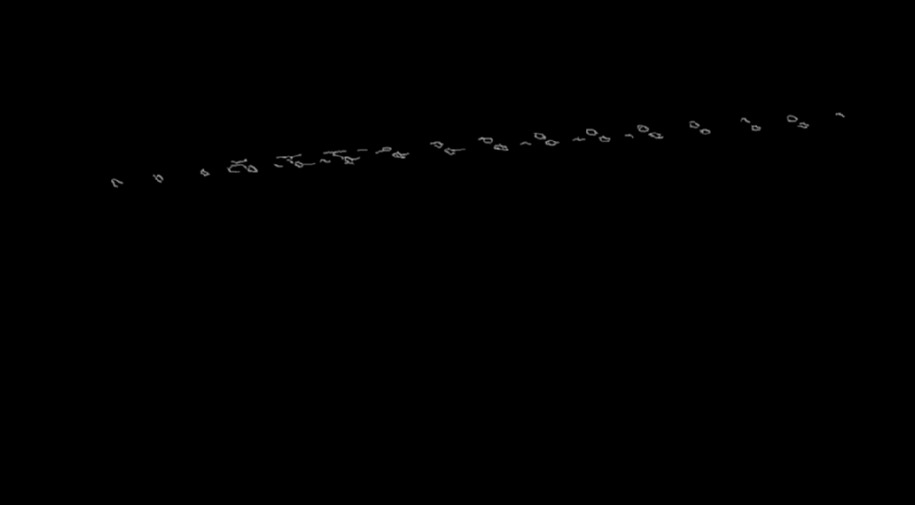
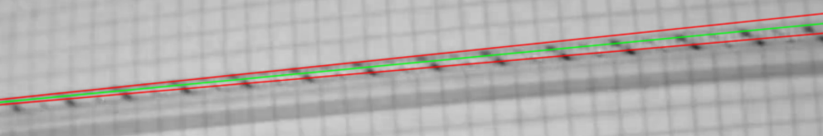
Theoretical Concepts
Identifying region of interest
-> Canny algorithm for edge detection
-> Hough lines through conjectured rope
-> rotation towards horizontal axis
-> cropped window around avg. Hough line
Figure 6: Canny edges (top), Hough Lines (middle channel), region of interest (bottom)

Slide 9
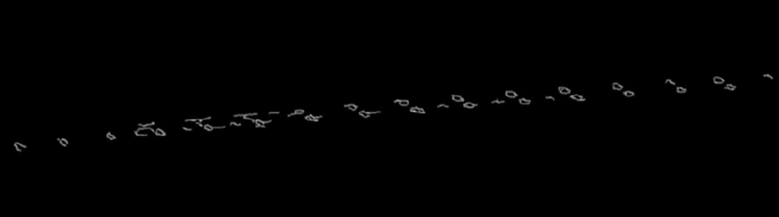
Theoretical Concepts
Canny algorithm
-> Gausian filtering
-> 5 x 5 Filter
-> detecting intensity gradients
-> Sobel filter
-> Non-Maximum Suppression
-> finding thin edges
-> Hysteresis Thresholding
Figure 7: Canny edges detail view

Slide 10
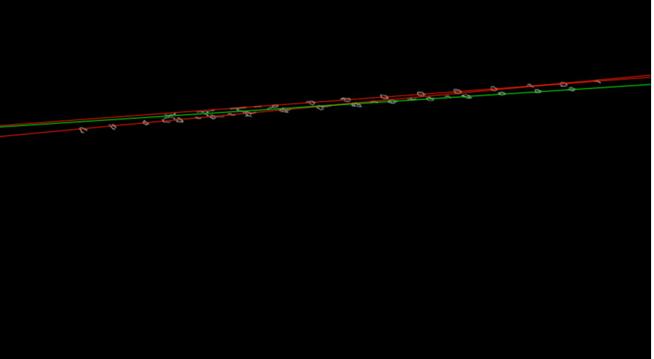
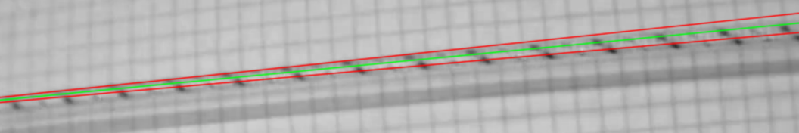
Theoretical Concepts
Hough lines
-> tracking intersections between curves of every
point (x, y)
-> number of intersections above threshold (th)
has line (θ,r_{θ}) through point (x, y)
Figure 8: Canny edges with examplary Hough Lines (top), Hough Lines in region of interes (Bottom)

Slide 11
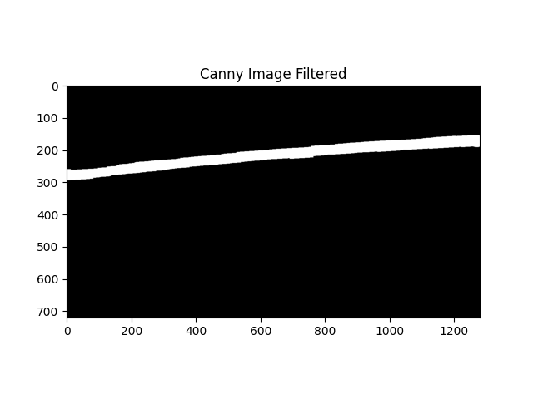
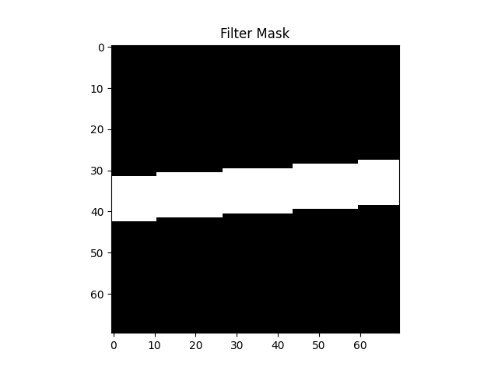
Theoretical Concepts
Determining the width:
-> we know the angle of the rope
-> make a linear filter smudging in that direction
-> find edge of white region

Slide 12
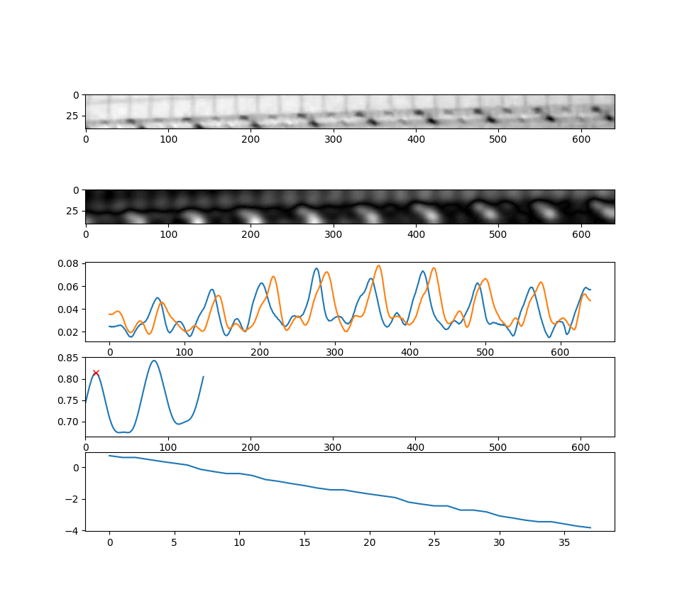
Shift Detection by Correlation
Distance in Pixels
Encoding the rope:
->difference of gaussian blurs as preprocessing
->sum every column to get a curve of brightness
->initialize a base brightness as reference
->period of the signal is determined from the base
brightness at initialization
distance
time

Slide 13
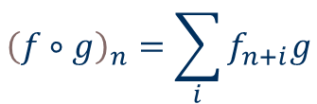
Shift Detection by Correlation
Distance in Pixels
Correlation:
-> The correlation of two functions describes how well they match for every offset
->index of the maximum of the correlation interpreted as offset describing best match
distance
$${\left(f∘g\right)}_{n}=\sum_{i}{f_{n+i}g}$$
time

Slide 14
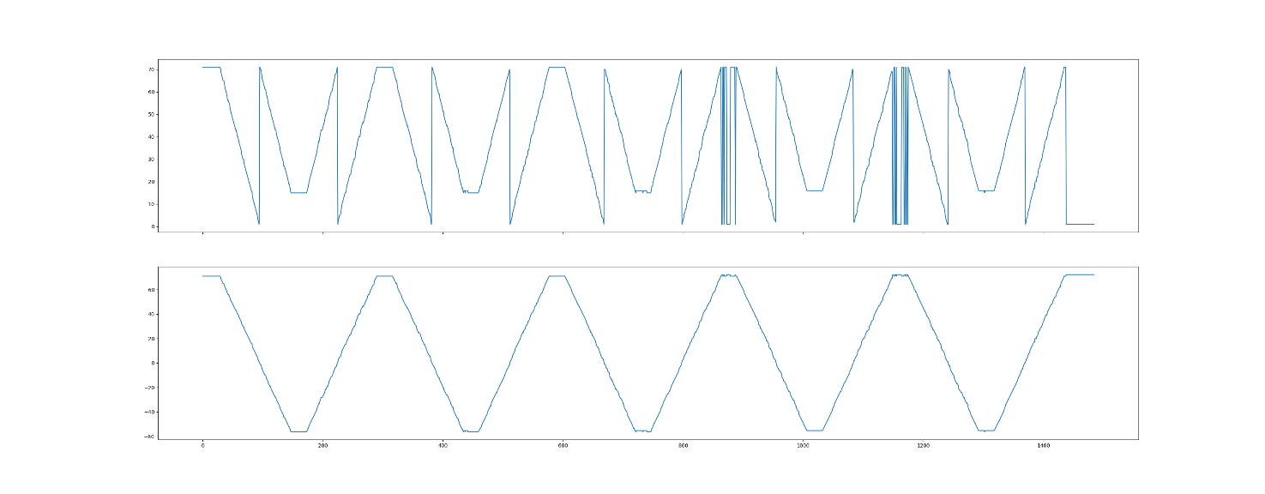
Shift Detection by Correlation
Phase Unwrapping:
-> we know the period of our signal
-> jumps of more than half a period are interpreted as a whole rotation of the opposite direction

Slide 15
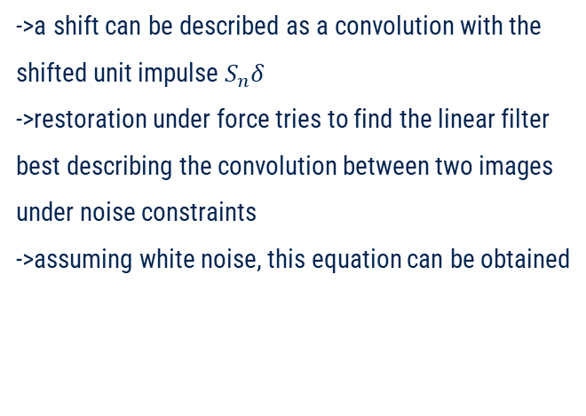
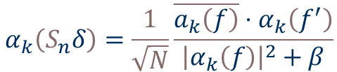
Shift Detection by Restoration
->a shift can be described as a convolution with the shifted unit impulse $S_{n}δ$
->restoration under force tries to find the linear filter best describing the convolution between two images under noise constraints
->assuming white noise, this equation can be obtained
$$α_{k}\left(S_{n}δ\right)=\frac{1}{\sqrt{N}}\frac{\overline{a_{k}\left(f\right)}⋅α_{k}\left(f^{′}\right)}{{\left|α_{k}\left(f\right)\right|}^{2}+β}$$
Voss, K., Suesse, H., Ortmann, W., & Baumbach, T. (1999). Shift detection by restoration. Pattern recognition, 32(12), 2067-2068.

Slide 16
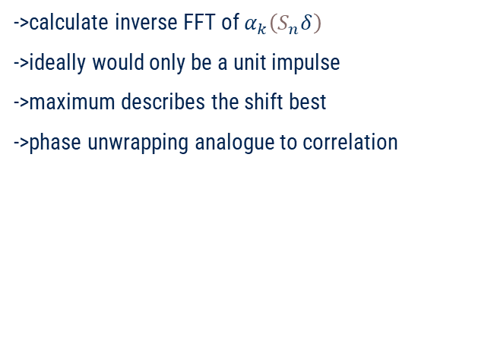
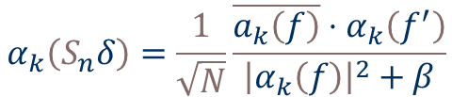
Shift Detection by Restoration
->calculate inverse FFT of $α_{k}\left(S_{n}δ\right)$
->ideally would only be a unit impulse
->maximum describes the shift best
->phase unwrapping analogue to correlation
$$α_{k}\left(S_{n}δ\right)=\frac{1}{\sqrt{N}}\frac{\overline{a_{k}\left(f\right)}⋅α_{k}\left(f^{′}\right)}{{\left|α_{k}\left(f\right)\right|}^{2}+β}$$
Voss, K., Suesse, H., Ortmann, W., & Baumbach, T. (1999). Shift detection by restoration. Pattern recognition, 32(12), 2067-2068.

Slide 17
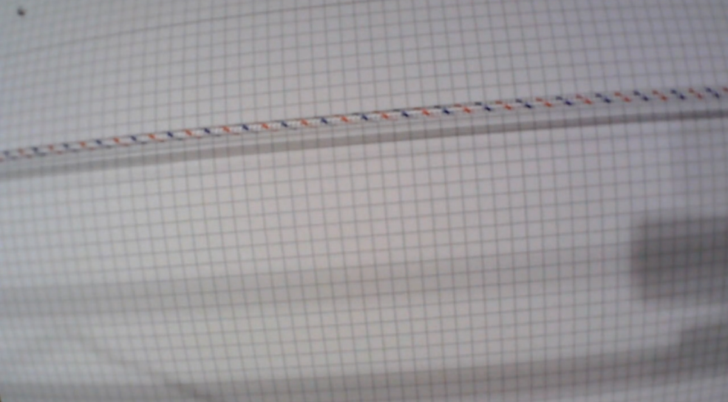
Project Evaluation
What works:
-> linear encoder is able to reliably track distance moved
-> can correct slipping ropes
-> footage can have minor distractions
-> steady camera position required
-> good lighting conditions without changes
Figure 9: test footage frame with shadows in the bottom right part of the image

Slide 18
Project Evaluation
Future work:
->resistance against axially rotating ropes
->dynamic region of interest
->better error handeling
->publish the library on PyPi
->build a V-Plotter using the library
Figure 10: rotating spiral pattern disturbs rope encoding

Slide 19
Demo

